Slide 1

Software Design and architecture (SE322) gg
Week 01
Said Nabi
said.nabi@giki.edu.pk
Faculty of Computer Science and engineering
Gik Institute Topi, Swabi

Slide 2
Course TA
Instructor
Email: said.nabi@giki.edu.pk
Webpages: https://tecplace.net/ https://humanizetextai.com/
Office: NAB 2nd Floor, S22
Telephone Extension: 2154
Office Hours:
Monday/Thursday 9:00 AM - 4:00 PM
Yet to be decide
Never hesitate to contact TA or me whenever you have some problem

Slide 3
Some Rules
There is only one rule that will make the rest of the rules
Raise your hand before asking any question and then WAIT for the permission
Never ever miss a class
Never ever “sleep” in the class
Never even think to use mobile phones in the class
Always communicate in the official communication language

Slide 4
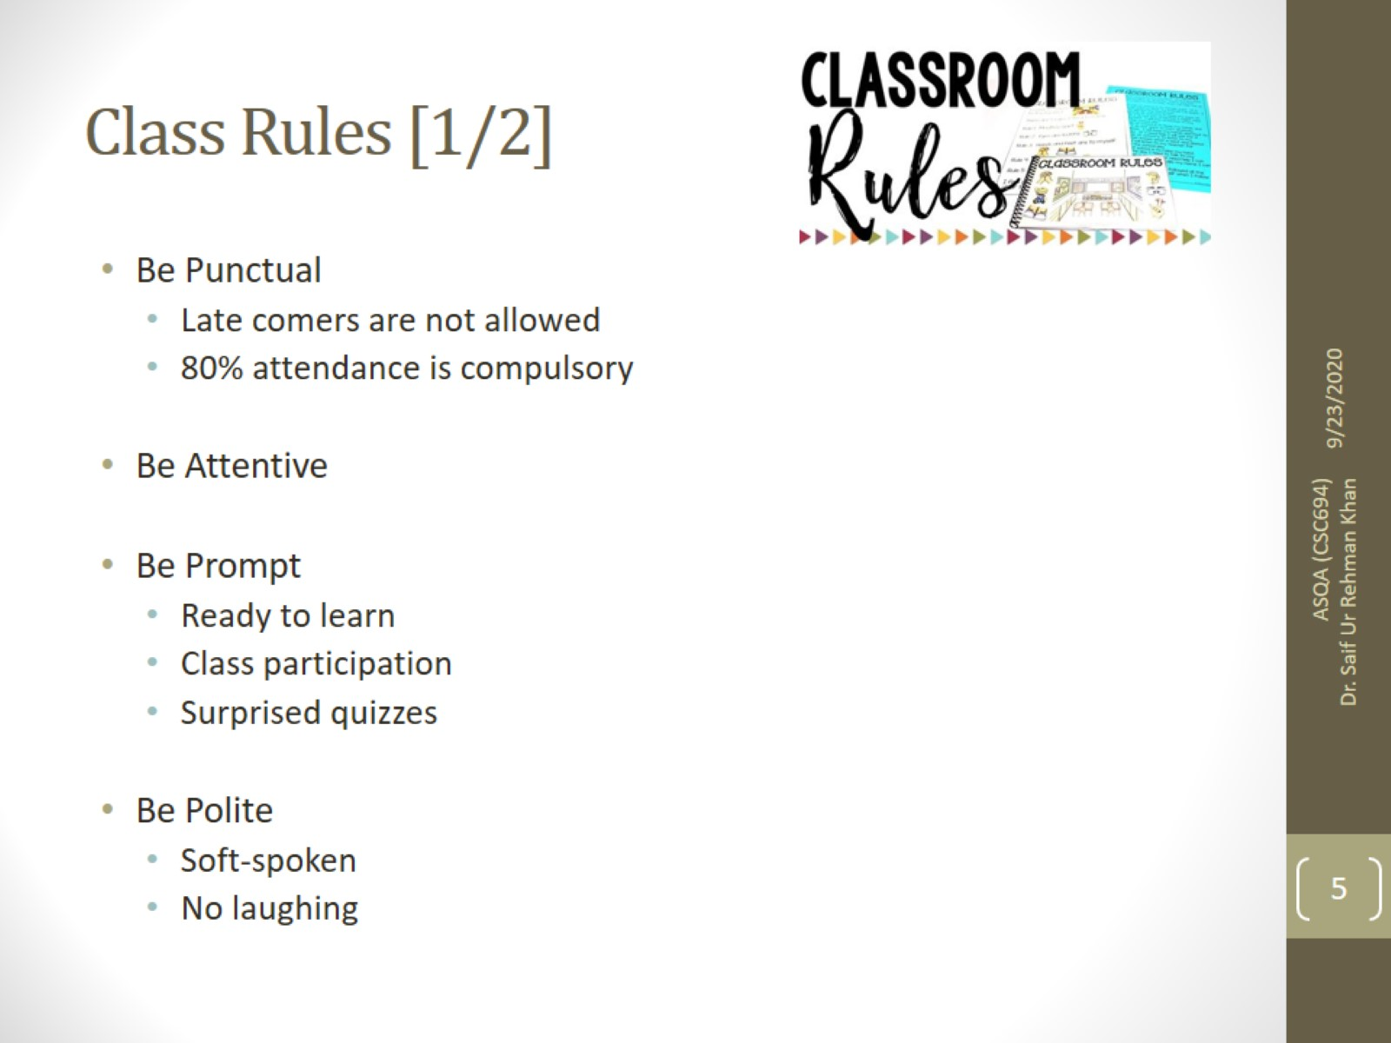
20/01/2025
4

Slide 5
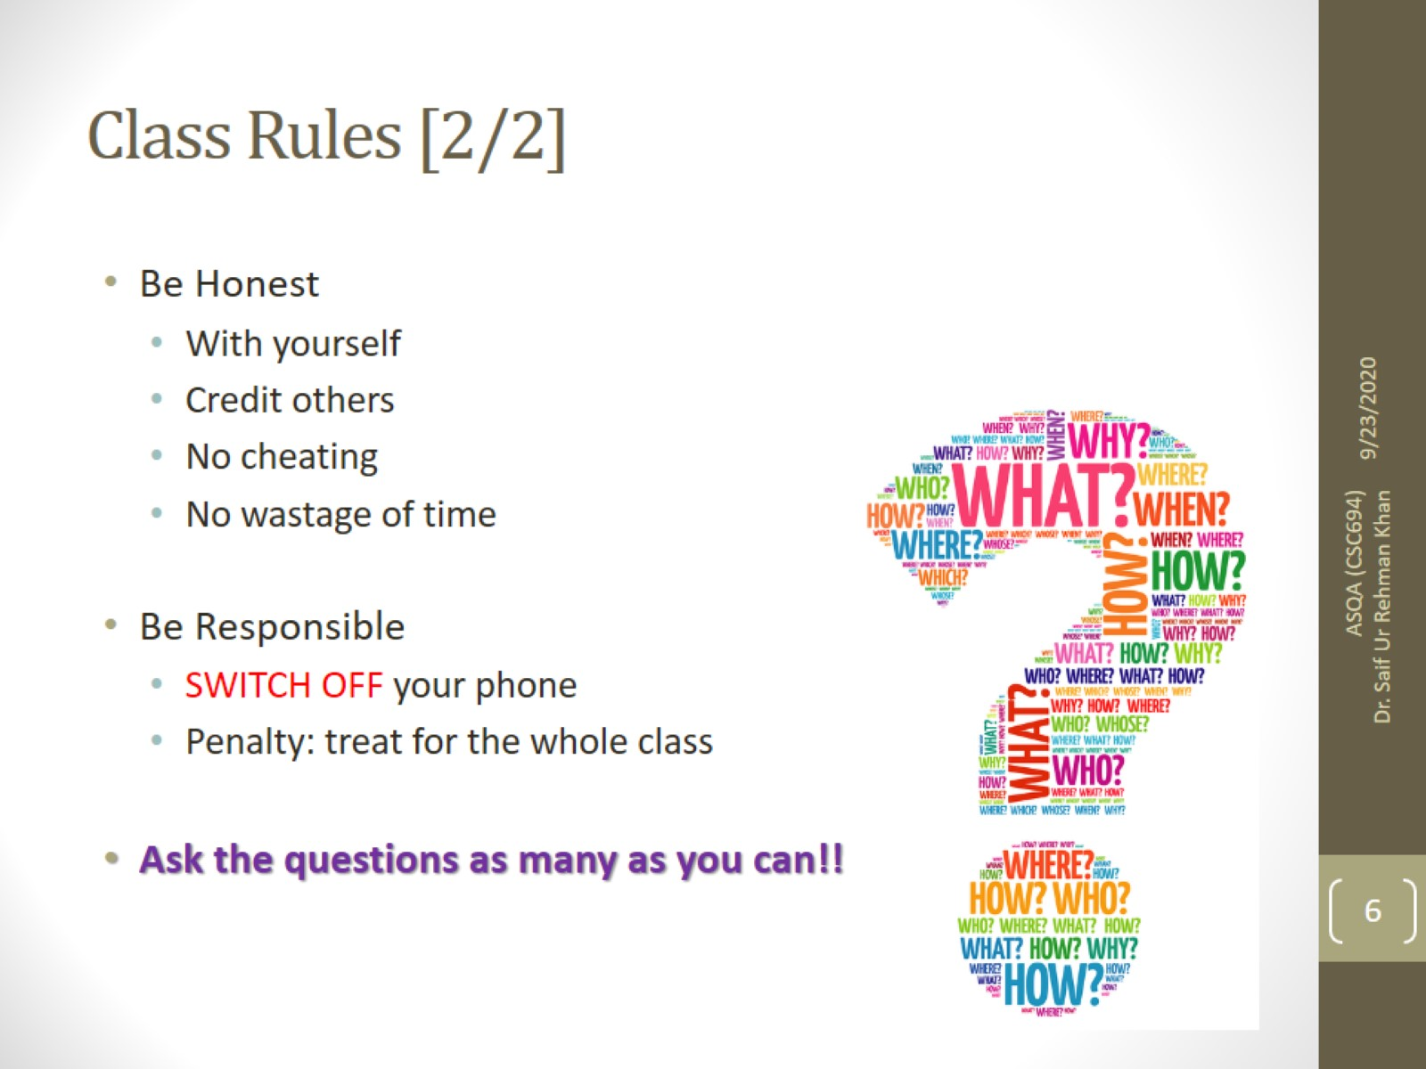

Slide 6

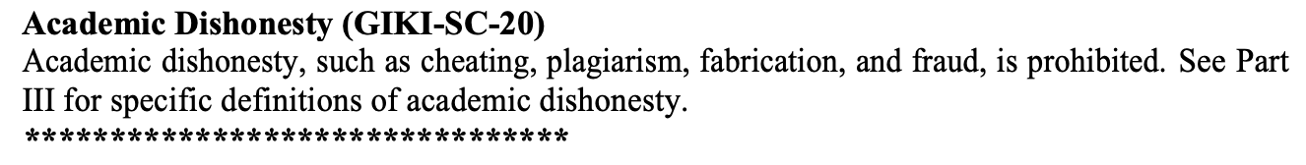
Dishonesty, Plagiarism in Quizzes, Assignments
All individuals involved in any kind of cheating in any exam, quiz, assignment or project will get -50% score.

Slide 7
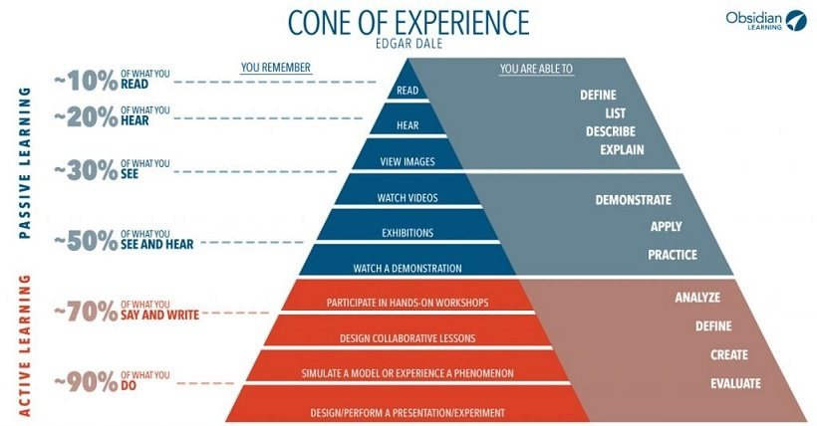
Remember

Slide 8
Tentative Evaluation Breakdown
Assignments (6) | 10
Quizzes (6) | 15
Term Project (1) | 15
Midterm (1) | 20
Final (1) | 40
Total | 100

Slide 9
Course Execution
3 lectures of one hour every week
1 lab of three hours every week, SE322L
Mind it: Lecture scheduling is to be done by the Dir. (A&E). Please avoid visiting me for any clashes

Slide 10

Motivation
Almost every large and complex industrial project follow a detailed design.
Every safety critical system must be well designed according to their safety standards.
Industry hire requirement analysts and software designers to model the ongoing projects.
Design artifacts carry a major weightage in FYP.

Slide 11
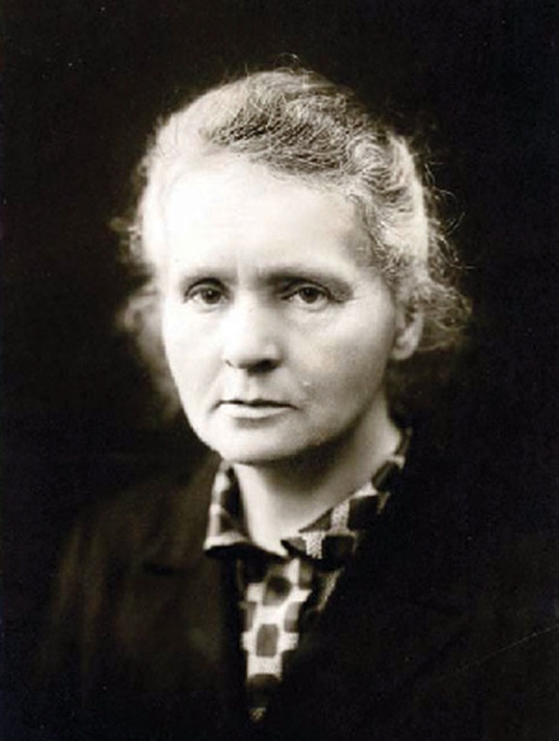
Motivation Cont…
Nothing in life is to be feared, it is only to be understood. – Marie Curie
Ensure alignment with business goals.
Address non-functional requirements such as scalability, performance, and security.
Notes:
Nothing in life is to be feared, it is only to be understood. – Marie Curie

Slide 12
Outline
Introduction to the Course
Course Objectives
Why this course is important for you?
Course Contents and Structure
Object Oriented Modeling
Requirements and Design
Conceptual Design and Technical Design

Slide 13
Lecture Format
Start with Q & A
Main Lecture
No short breaks in the middle
Practice sessions on various case studies
Designing/Modelling of software artifacts
Translation of design artifacts into code
Notes:
Practice sessions on various case studies
Designing/Modelling of software artifacts
Translation of design artifacts into code

Slide 14
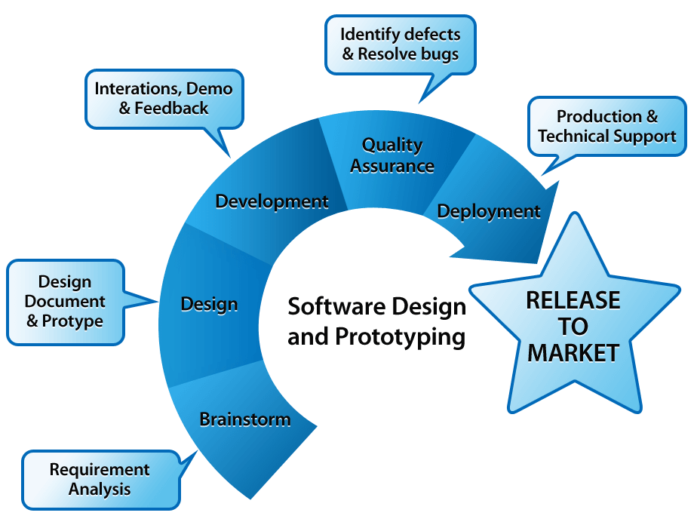
Software Development Process
Notes:
Repeated cycle of activates.

Slide 15
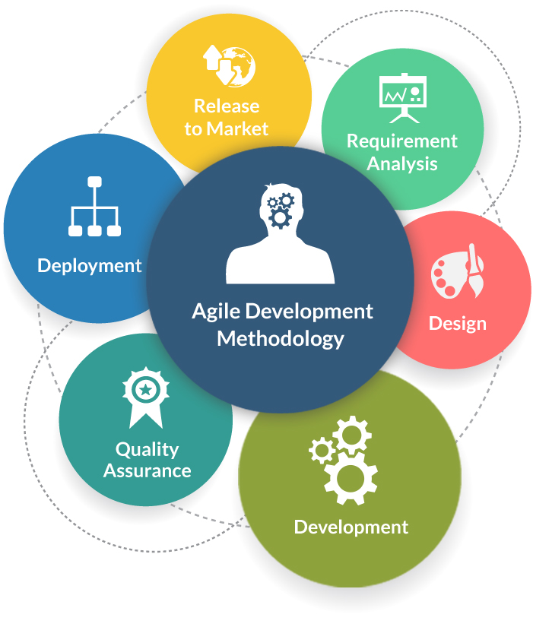
Software development Methodologies
Frequent alteration in the development project
Minimize risk by developing software in short time boxes
Changing requirements of the clients.
Notes:
Frequent alteration
Minimize risk
Changing requirements

Slide 16
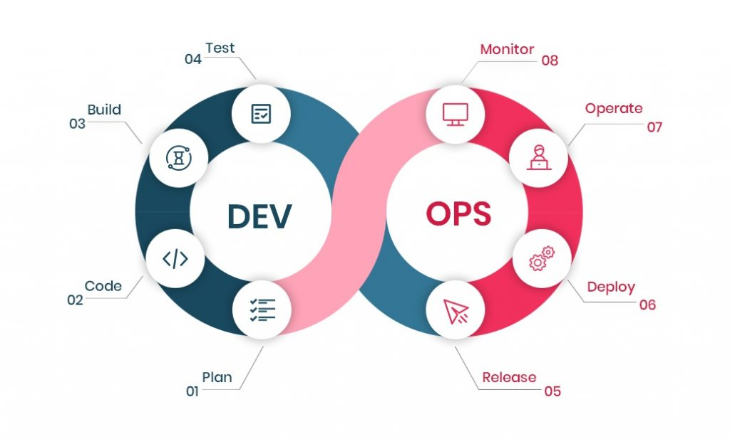
Cont..
Follow continuous integration and continuous delivery model
development and operational teams to perform everything simultaneously in development, quality assurance, security, and other operations.
It makes the process faster and easier for businesses to process on time

Slide 17
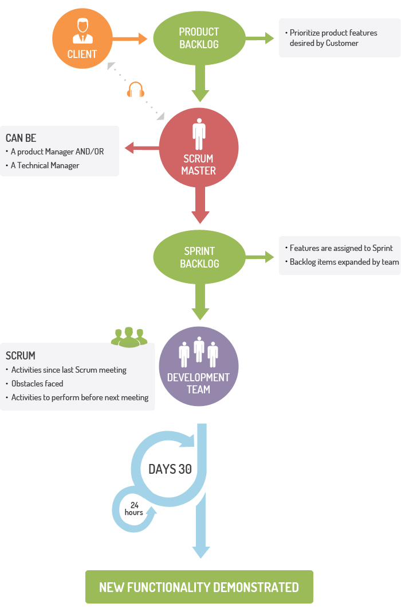
Cont..
For companies where the requirements are highly emerging and rapid changes are easily adhered to.
daily meeting easily helps the developer to make it possible to measure individual productivity.
Due to short sprints and constant feedback, it becomes easier to cope with the changes

Slide 18
Traditional Software Development Flow
When a software developer begins work with a new project, it's natural for him to choose to commence scripting the code immediately.
Regardless of his software knowledge, if someone produces software without laying out a strategy for it, he might as well have been laying bricks without establishing a solid foundation.
The building will fall no matter how robust the construction process and resource consumption are; similarly, the software would fail without a fundamental layout.
Nobody wants their efforts to be for waste because they didn't have a plan for them, right? That's where software design comes in, a mechanism that simplifies important software operations in a certain way.

Slide 19
Course Structure
3 Credit Hour Course (More applied than you think)
3 Hours lab
Programming Language and Tools
Java
UML Case tools like Enterprise Architect, Papyrus etc.
Course Project
Vital and major component of the course
Group of (2-3) students
Weekly Task
Coding Tasks

Slide 20

The main Focus of the Course:
Software Requirements Specifications
Software Design Process
Blueprint For implementation
Notes:
Requirements = What the client dreams of
Design = How we transform that dream into a plan
Blueprint = The guide that ensures the dream is built right

Slide 21
Course Contents
Outline
Software Design vs. Software Architecture
UML Diagrams (Class, Use Case, Sequence, Deployment)
SOLID Principles
GoF Patterns
Factory Method Pattern
Singleton Pattern
Adapter Pattern
Composite Pattern
Observer Pattern
Strategy Pattern
Layered Architecture
Microservices Architecture

Slide 22
Textbooks and Supplementary Reading List
Text Book(s)
Design patterns elements of (Gang of 4).pdf
Designing Software Architectures A Practical Approach Humberto Cervantes Rick Kazman
Bernd Bruegge, Allen H. Dutoit, Object-Oriented Software Engineering, using UML, Patterns, and Java.
UML 2.0, Documentation:www.rational.com
Fundamentals of Software Architecture
Additional Reading List
Unified Modeling Language: Superstructure, version 2.1.2, formal/07-11-02, OMG, www.omg.org

Slide 23



Software use during this course
UML (Designing/Modeling Standard)
Rational Software Architect (Modeling tool)
Eclipse IDE (Development IDE)

Slide 24
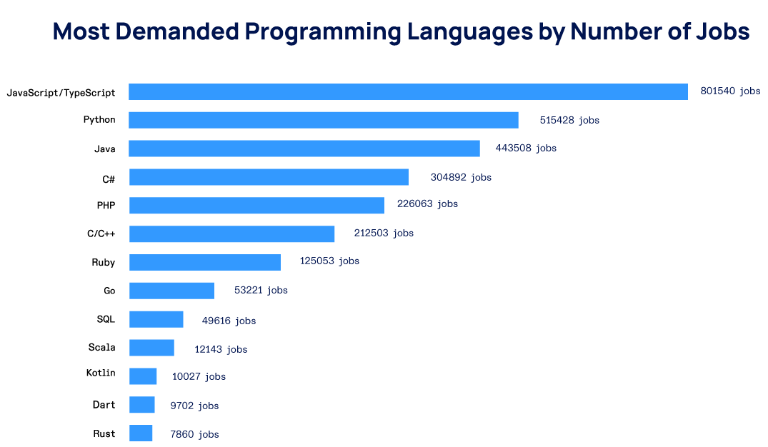
Why Java?

Slide 25






Understanding Software Design & Architecture:
Before we build software, we must decide how to build it.
Both are essential for creating reliable, long-lasting systems.
The same role can look very different in different companies.
Software design focuses on details, software architecture on the big picture.
Great software is not built by accident — it’s designed.
Notes:
Before we build software, we must decide how to build it.
Both are essential for creating reliable, long-lasting systems

Slide 26
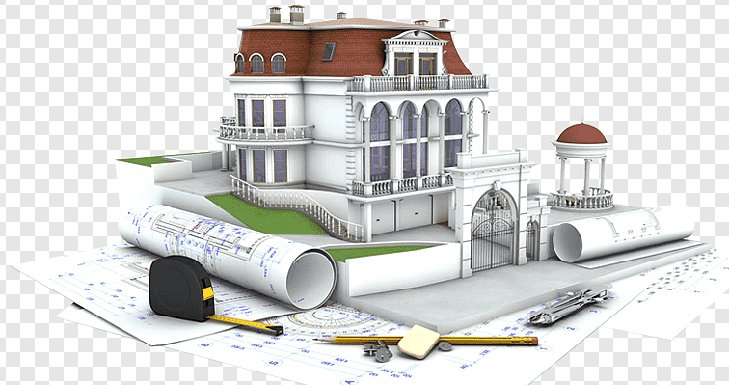
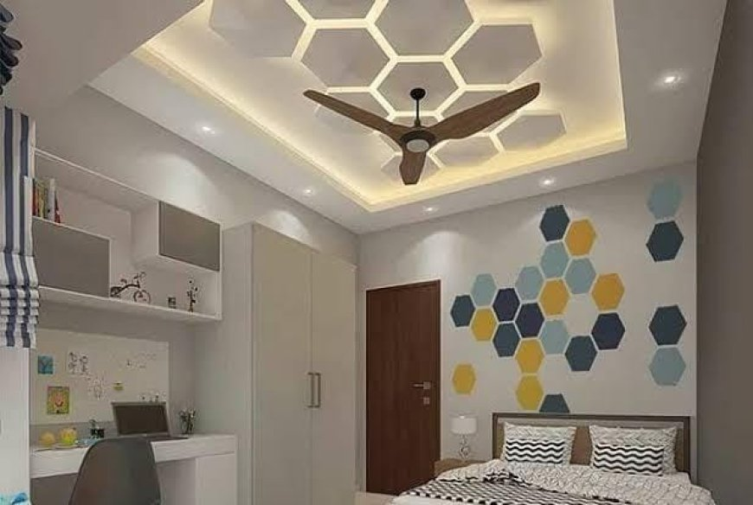
The Core Difference:
Software Design:
Focuses on how individual parts work internally.
Deals with detailed component responsibilities.
Software Architecture:
Focuses on how all parts work together.
Chooses frameworks, databases, integration patterns.

Slide 27
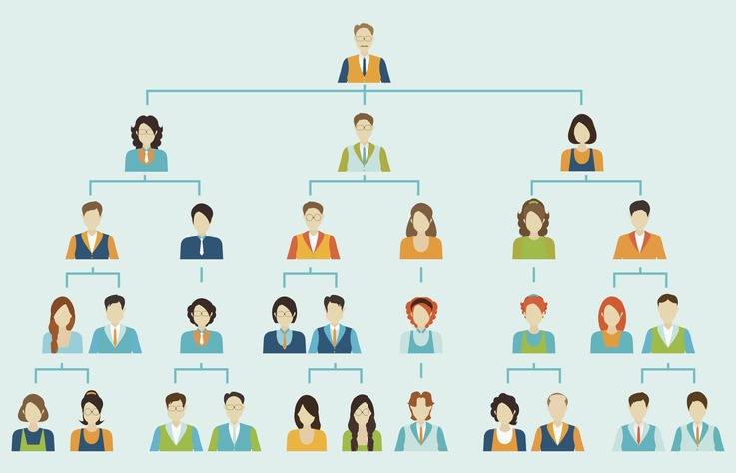
What Shapes These Roles?
If you were in a 5-person startup, would you separate design and architecture?
What happens if a big project has no clear architect?
Company size & structure influence responsibilities.
The project’s scope & complexity define how much planning is needed.
Team experience impacts how much guidance is required.
Startups often blur roles; enterprises separate them.
Notes:
The environment shapes whether design and architecture are distinct roles

Slide 28

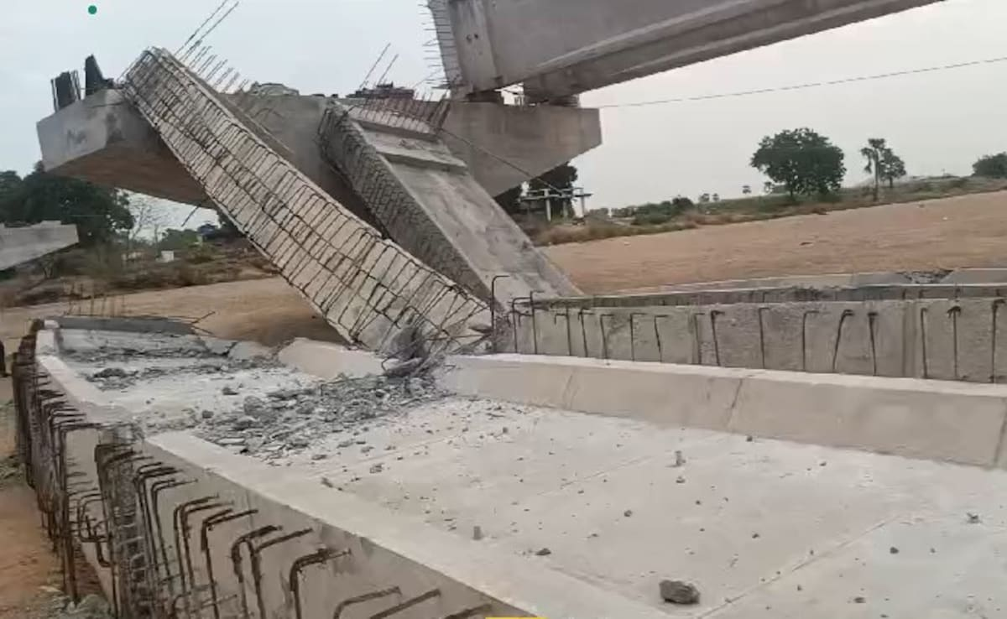
Why It Matters:
Good design & architecture → scalable, maintainable, successful software.
Bad architecture → costly failures and rewrites.
Aligns business goals with technical reality.
What’s an example of a product that failed because of poor design or planning?
If a building’s foundation is weak, what happens over time?
Notes:
Without proper architecture, a new feature might break existing ones.

Slide 29
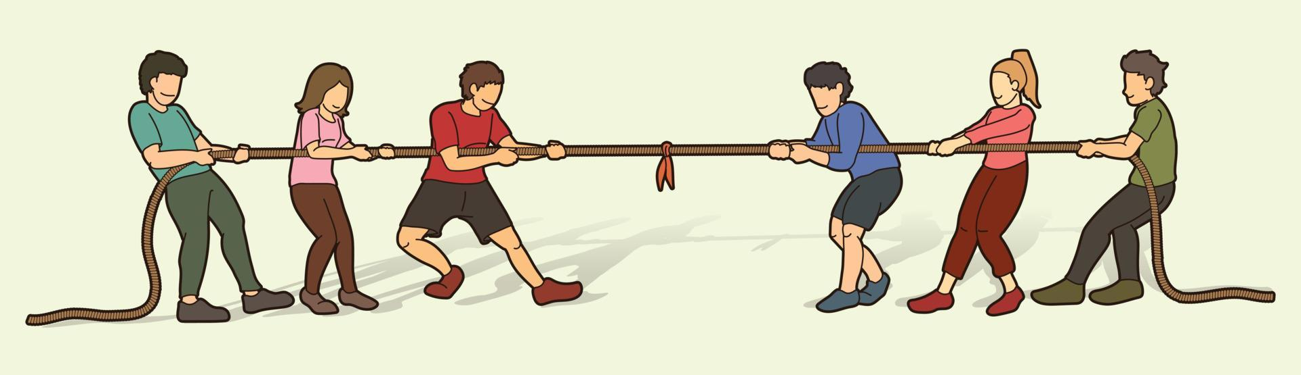
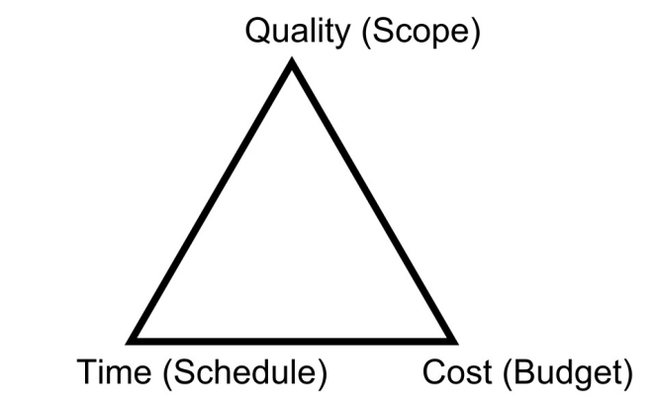
Goals of SDA:
Speed vs. Quality: Balancing urgent delivery with long-term stability.
Unclear Requirements: Clients often don’t know exactly what they need.
Cross-Discipline Communication: Bridging the gap between business and technology.
Robustness — resistant to failures.
Maintainability — easy to update.
Scalability — handle growing users.
Notes:
Uber : ask questions, probe, and clarify
What is robustness : Online banking system handles server failure without losing transactions.
Maintainability: Bug fixes can be made without rewriting large portions of code.
Scalability: Social media platform adding servers to handle traffic spikes.
Netflix scaling from 100k to millions of concurrent users.

Slide 30
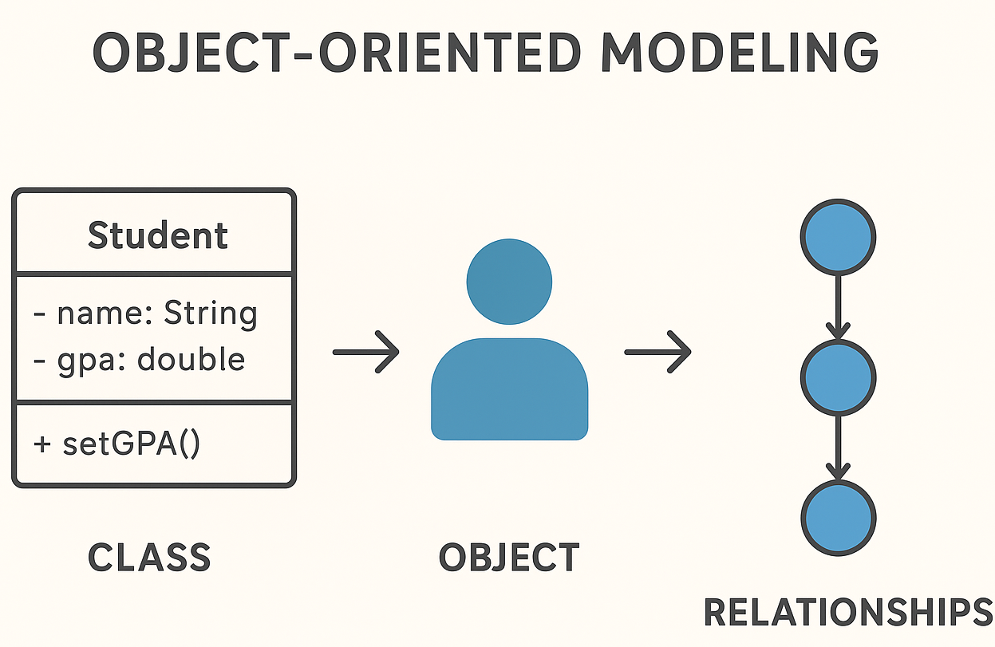
Object Oriented Modeling:
Not limited to coding — applies beyond software development
Break problems/concepts into component parts (objects)
A tweet on Twitter = object
A product in online shopping = object
Object-oriented modelling = represent key concepts as objects in software
Objects can represent people, places, or things
Objects hold specific details (attributes):
Person → name, age, gender, occupation
Place → name, size
Object → dimensions, color
Notes:
It thinks in terms of millions of interacting objects.

Slide 31
Objects and Responsibilities:
Objects have behaviours/responsibilities
Person → sitting, typing
Device → power on/off, display image
Benefits of using objects in code:
Organized
Flexible
Reusable
Objects are self-aware in software
Phone “knows” its specifications
Chair “knows” its dimensions and location
In object-oriented thinking:
Everything can be considered an object (animate or inanimate)
All objects are self-aware

Slide 32
Practicing Object-Oriented Thinking:
Good practice: view the world as OBJECTS with ATTRIBUTES
Examples: COMPUTER, PERSON, FURNITURE
Each object has DETAILS (ATTRIBUTES) and BEHAVIOURS (RESPONSIBILITIES)
COMPUTER
PERSON
Even the ROOM itself can be an OBJECT
Attributes: SEATING CAPACITY, ROOM NUMBER
Responsibilities: PROVIDE SPACE, HOST ACTIVITIES
Key idea: train yourself to SPOT OBJECTS everywhere and think of their DETAILS & BEHAVIOURS

Slide 33
Design in the Software Process
When SOFTWARE is developed, it goes through a PROCESS
a PROCESS takes a PROBLEM → creates a SOLUTION A process is generally ITERATIVE
Iterations: take REQUIREMENTS from PROBLEM(S)
Create CONCEPTUAL DESIGN MOCK-UPS and TECHNICAL DESIGN DIAGRAMS
Use them to build WORKING SOFTWARE IMPLEMENTATION
Must also PASS TESTING
This cycle is REPEATED for each set of requirements until a COMPLETE SOLUTION is created
Many projects FAIL when this process is SKIPPED
Jumping directly to CODING without proper REQUIREMENTS and DESIGN leads to failure

Slide 34
Design in the Software Process Cont..
Important to allot TIME for REQUIREMENTS and DESIGN
Even if they are not PERFECTLY ESTABLISHED
CODING relies on ASSUMPTIONS
Once coding begins, CHANGING ASSUMPTIONS is very difficult
REQUIREMENTS and DESIGN activities clarify assumptions → ensure the RIGHT PRODUCT is built
Survey by The Standish Group: 31% projects get failed due to improper planning of requirements.
Diving straight into IMPLEMENTATION is a leading cause of PROJECT FAILURE
Next: Steps of REQUIREMENTS and DESIGN in the process
Think like an ARCHITECT → consider STRUCTURE + BEHAVIOUR of software
DESIGN WORK = outlining a SOLUTION, may include evaluating ALTERNATIVES

Slide 35
What are Requirements?
REQUIREMENTS = conditions or capabilities that must be implemented in a PRODUCT
Based on CLIENT / USER REQUESTS → starting point of any project
Goal: Understand what the client wants before coding
Eliciting requirements goes beyond client’s vision:
Actively PROBE their ideas
CLARIFY what is not stated
ASK QUESTIONS about hidden issues
Helps reveal the FULL SCOPE of the product
Notes:
Actively PROBE their ideas
CLARIFY what is not stated
ASK QUESTIONS about hidden issues

Slide 36
What are Requirements? Cont..
Important to establish TRADE-OFFS with the client
sacrifice a FEATURE to improve SPEED if performance is critical
Once requirements + trade-offs are clear → they become the FOUNDATION for DESIGN
ARCHITECT building a HOUSE
Client lists rooms → but architect must ASK FOLLOW-UP QUESTIONS:
Are any rooms missing?
What SIZE should the house/rooms be?
Any CONSTRAINTS / RESTRICTIONS?
How should rooms be PLACED?
Which DIRECTION should the house face?
These details = better understanding of what you will BUILD

Slide 37
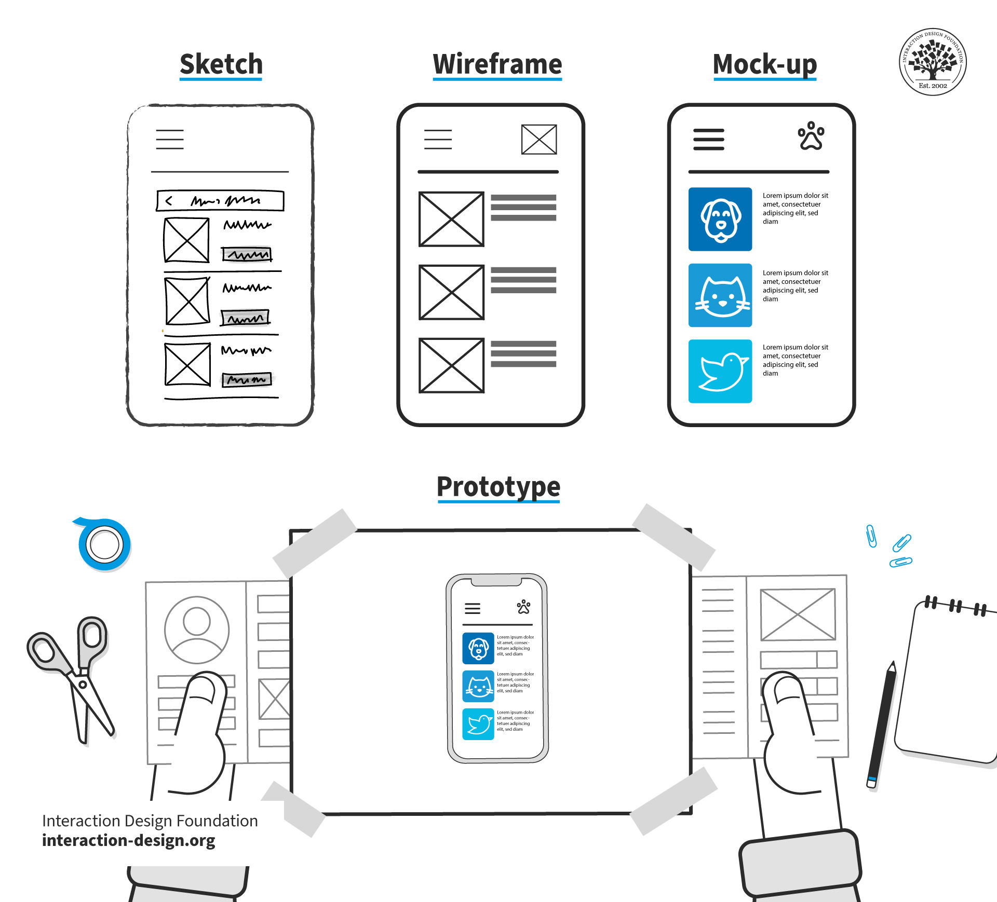
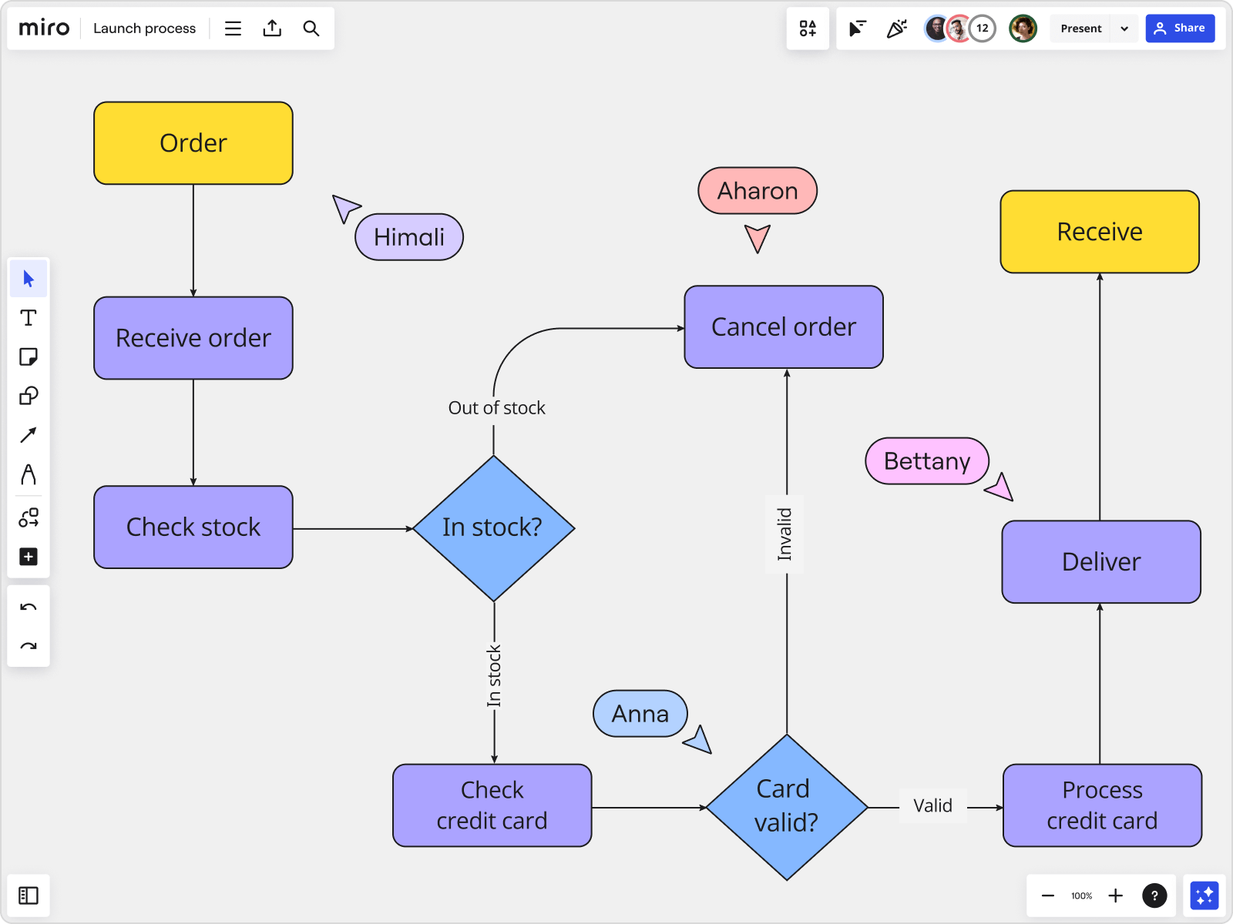
Design (Overview):
After REQUIREMENTS, next step = DESIGN
Two main kinds of ARTIFACTS:
CONCEPTUAL DESIGN (mock-ups)
TECHNICAL DESIGN (diagrams)
CONCEPTUAL DESIGN = high-level view
TECHNICAL DESIGN = detailed, specific view
Goal: ensure REQUIREMENTS → DESIGN → IMPLEMENTATION flow smoothly

Slide 38
Conceptual Design:
Based on INITIAL REQUIREMENTS
Identifies COMPONENTS, CONNECTIONS, RESPONSIBILITIES
Expressed through CONCEPTUAL MOCK-UPS
Visual notations = initial thoughts on requirements
Wireframes often used for USER INTERFACES
Can be hand-drawn sketches or computer tool drawings
Purpose of mock-ups:
Clarify design decisions with CLIENTS / USERS
Show major components & connections
Reveal missing parts / flaws early
Components have RESPONSIBILITIES (tasks they must perform)
No technical details yet (those belong to Technical Design)

Slide 39
Conceptual Design Cont..
Components: lot, house, rooms
Connections: how rooms are accessible
Responsibilities:
House → provide power, water, support
Kitchen → store appliances, food, provide space, power, water
Conceptual Design excludes technical details
NO wiring/plumbing specifics yet
Size of electrical panel decided later in Technical Design
Best Practice:
Always form CONCEPTUAL DESIGN first
Clear conceptual design → better technical design → higher chance of correct SOFTWARE BUILD
Notes:
No details of

Slide 40
Thank You☺

